Slide 1

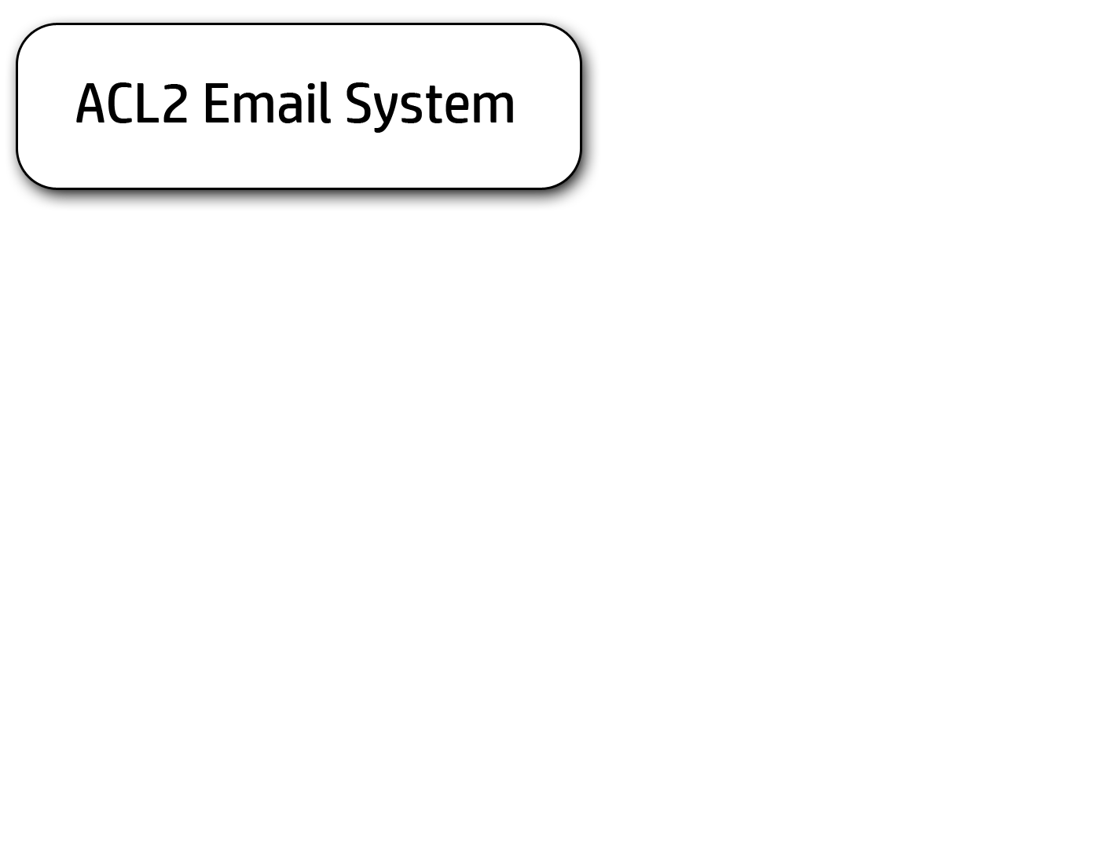



Slide 2
The Motivation
Utilize ACL2 to provide for theoretically proven data transformations.
Not all information is theoretically sound.
Leverage additional languages to provide for intuitive feedback.
Java
XML
Utilize multilevel design that is easy to build upon.
Modular development system
Less impact on deliverables
New standard for email storage
XML structures
What it is not:
Email system based on current standards for Email transmission
What it is:
Isolated email system with the potential to expand into the currently accepted transmission system.

Slide 3
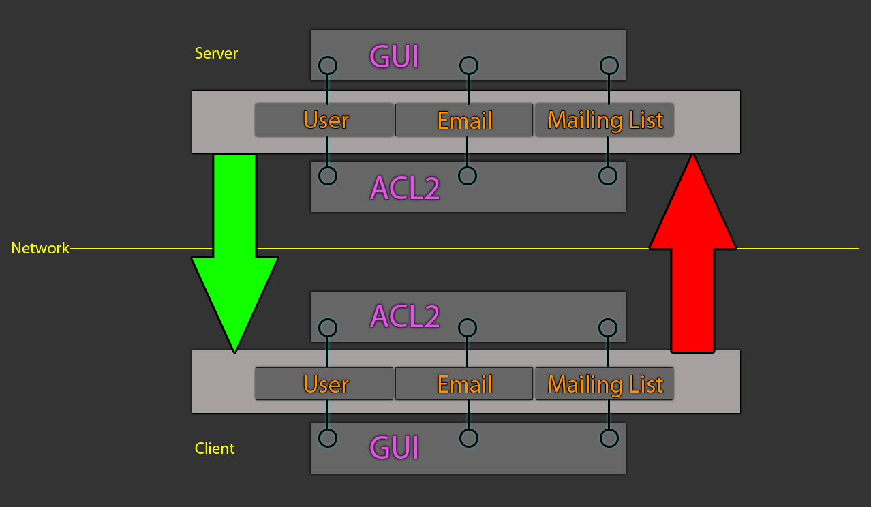
The Architecture

Slide 4
The Module Structure
3 Main Components
The Logic
The Tests
Predicate Based Randomized Testing
Theorems
Check-Expects
The Actions
Networking
File IO
GUI
Is not limited to ACL2 Email but may be expanded to process anything that requires client/server interaction.

Slide 5
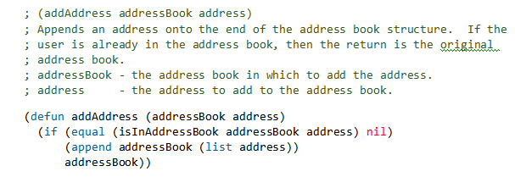
The Logic
Written only in ACL2
No IO, no includes, strictly logic
Higher level processing delegated to actions.
Type Casting

Slide 6
The Tests
Property Based Randomized Testing
Uses random values to test against a hypothesis.
Helps us to determine a theorem.
Theorem Based Testing
Utilizes a formulated theorem to inductively prove the theorem.
Provides theoretically sounds transformations.
Check-Expects
Theorems might not do exactly what you want it to do.
Discrete input, discrete output comparison for validation.

Slide 7
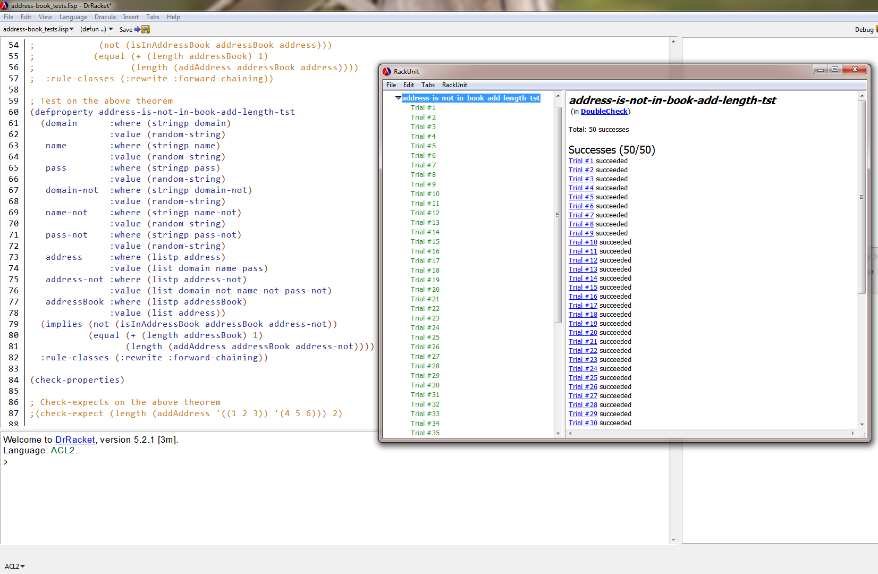
Property Based Randomized Testing

Slide 8
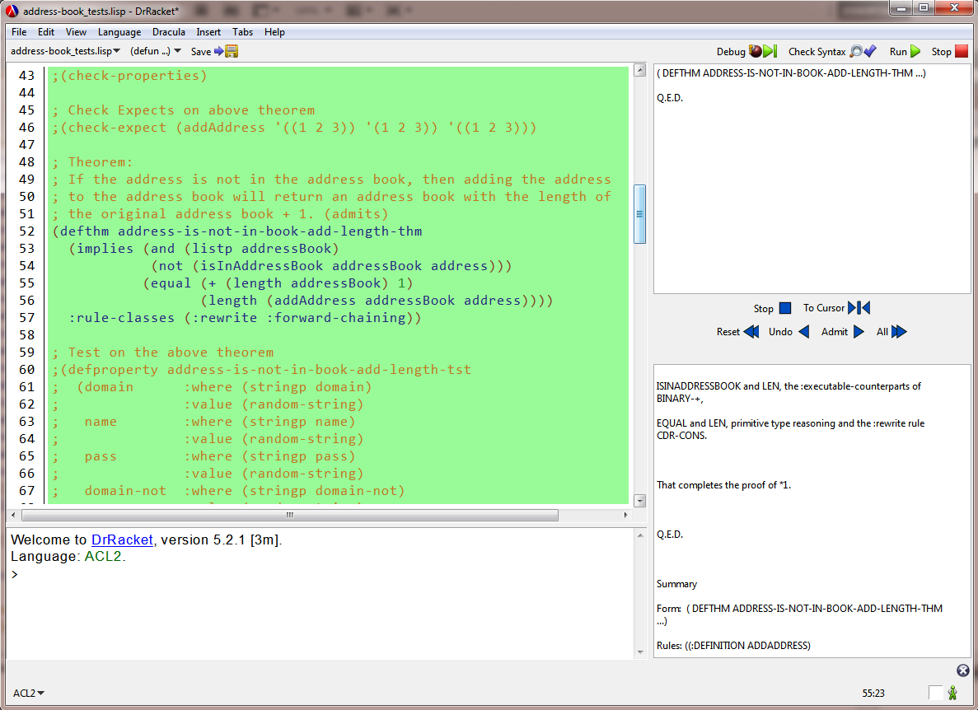
Theorem Based Testing

Slide 9
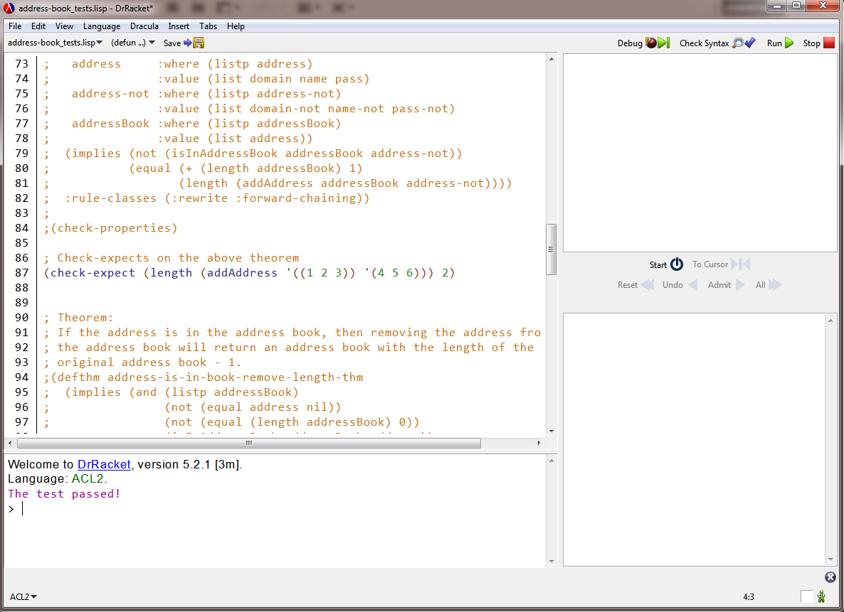
Check-Expect

Slide 10
The Actions
Contains the File IO actions
Contains the link networking protocols
Contains the link to GUI content
Can become rather large based on “fanciness” of the GUI
Written in both ACL2 and Java.
Uses XML as a transport medium.
Structure is enforced via document type definitions.
Type casting and input manipulation must occur at this level.

Slide 11
Implementation
Can be done via program wrapper or module integration.
Server utilizes program wrapper method.
Each module is a stand-alone application
Integration does not affect the run state of the server.
Similar to Apache HTTPD
Client utilizes module integration.
Requires source code intervention.
Maintains a sound structure with no deviation from expectation.

Slide 12
Demonstration
User Registration
Email Sending
Email Retrieval / User Verification

Slide 13
Fun Facts
The minimal structure for a module has a 60/30 split (60% is ACL2, 20% is augmented languages)
This can change based on user’s feedback level from the GUI elements.
Each module can run on its own without a server or client wrapper present.
Promotes modular development without impacting deadlines of other modules.
Can develop modules concurrently.

Slide 14
The Team
Matthew Crist
Server side development
Wesley Howell
Email structure (server side), client side development
Adam Ghodratnama
Client side development

Slide 15
Development Process
Prototyping
Provides a means of accepting or abandoning intended modules.
Accepted:
User Registration
User Verification
Email Transaction
Partial Complete:
Mailing Lists
Email Blocking
Rejected:
Spam Filtering
Stayed in line with the current architecture and promoted a more adaptive product.
A lot of testing had to occur up front.
C -> Shell Scripting (Bash)
Shell Scripting (Bash) -> Java
Networking in ACL2
Synchronization with “nc”
Adapting personnel
Lost a developer three weeks into development
Resulted in prioritization of modular development.
SVN used to maintain code

Slide 16
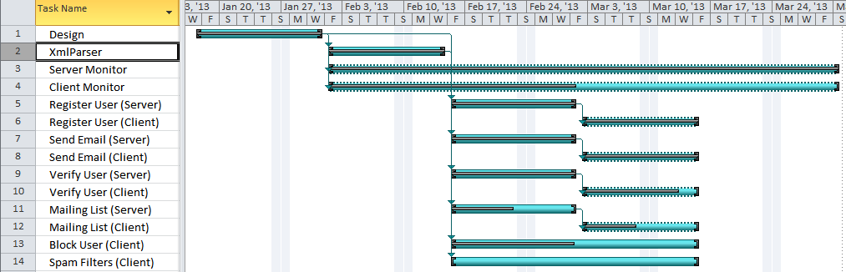
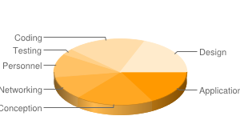
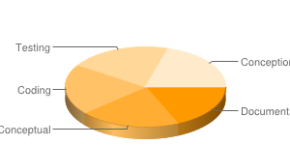
The Timeline
Time Per Defect
Time per Phase

Slide 17
Defects
Change Logs
Any changes to source were logged in source.
Person fixing dependent on defect severity.
Google Code Defect Database
Major defects impacting multiple individuals
Some modules have dependencies
May not affect input and output of a module dependency
PSP Defects
Generalized information regarding all defects
Generalized resolution descriptions
Fix Times

Slide 18
Questions?

